Slide 1
UPPER SIXTH ARTS
GEOGRAPHY
Practical Work 1
Calculating Locational Rent and Drawing Rent Curves
Notes:
Good morning, class, and welcome to our geography lesson. I am your geography teacher, Mr Kamdem. Today we are starting Practical Work 1: Calculating Locational Rent and Drawing Rent Curves.

Slide 2
CLASS INFO
Class, Chapter and Duration
Class | Upper Sixth Arts
Chapter | Module 6: Understanding and managing the dynamics of economic activities across the world in general and Cameroon in particular
Duration | 2 periods (2 × 50 minutes)
Notes:
This lesson is for Upper Sixth Arts. It belongs to Module 6: Understanding and managing the dynamics of economic activities across the world in general and Cameroon in particular. We shall need 2 periods to cover it.

Slide 3
IDENTIFICATION
Lesson Identification
Topic | Theories of Agricultural Land Use
Sub-topic | Theories of Agricultural Land Use
Lesson | Practical Work 1: Calculating Locational Rent and Drawing Rent Curves
Notions / Concepts | Locational rent, yield, price, production cost, transport cost, rent curve, land use pattern.
Syllabus focus | Calculation of locational rent for several crops; construction and interpretation of rent curves; land use patterns from rent curves.
Competence | Learners are able to calculate locational rent and draw land use zones.
Notes:
Our topic is Theories of Agricultural Land Use, and the sub-topic is Theories of Agricultural Land Use. The key notions we shall use today are: locational rent, yield, price, production cost, transport cost, rent curve, land use pattern. At the end, you should be able to do this: learners are able to calculate locational rent and draw land use zones.

Slide 4

HOMEWORK CORRECTION
Correction of the Homework
Question (Lesson 6: Von Thünen's Theory of Agricultural Land Use):
Draw the land use around your town and compare it with Von Thünen's rings.
Notes:
Before we start the new lesson, let us correct the homework I gave you at the end of Lesson 6: Von Thünen's Theory of Agricultural Land Use. The question was: Draw the land use around your town and compare it with Von Thünen's rings. Take out your exercise books.

Slide 5
HOMEWORK CORRECTION
Correction: Possible Answer
Around the town: vegetable gardens and poultry near the town; maize and sorghum fields further out; cattle grazing on the far edges, similar to Von Thünen's rings but stretched along roads.
Notes:
Here is a good answer. Around the town: vegetable gardens and poultry near the town; maize and sorghum fields further out; cattle grazing on the far edges, similar to Von Thünen's rings but stretched along roads. Compare it with your own answer and correct your work in red.

Slide 6
LESSON PLAN
Lesson Plan
Correction of the homework
Objectives and recall
Real-life situation and action to take
Learning activities
Board summary
Evaluation, remediation and homework
Notes:
Here is the plan of our lesson today. First, we shall correct the homework. Then we shall look at the objectives and recall what you already know. After that, we shall study a situation from real life and the action to take, and do the learning activities. Finally, we shall copy the board summary, do the evaluation and the remediation, and I will give you the homework.

Slide 7
OBJECTIVES
Objectives
By the end of this lesson, you should be able to:
Apply the locational rent formula.
Draw rent curves for several crops.
Deduce land use zones from the curves.
Notes:
By the end of this lesson, you should be able to do three things. Number 1: apply the locational rent formula. Number 2: draw rent curves for several crops. Number 3: deduce land use zones from the curves.

Slide 8
PREVIOUS KNOWLEDGE
Previous Knowledge
LR = Y(P − C) − Y·T·d.
The highest curve wins the land.
Notes:
Let us first remember what you already know. LR = Y(P − C) − Y·T·d. The highest curve wins the land. Keep this in mind, because we shall build on it today.

Slide 9
REAL-LIFE SITUATION
Situation in Real Life
An agricultural officer gives the class the yield, price, cost and transport rate of vegetables, wheat and cattle. The class must decide what should be grown at each distance from the town.
Notes:
Listen carefully to this situation from real life. An agricultural officer gives the class the yield, price, cost and transport rate of vegetables, wheat and cattle. The class must decide what should be grown at each distance from the town. Think about it, because I am going to ask you some questions.

Slide 10
REAL-LIFE SITUATION
Situation: Question 1
What is the problem in the situation?
Notes:
Question 1: What is the problem in the situation? Think for a moment, then raise your hand to answer.

Slide 11
REAL-LIFE SITUATION
Answer
The class must choose land use by distance.
Notes:
Good. The class must choose land use by distance.

Slide 12
REAL-LIFE SITUATION
Situation: Question 2
What must they calculate?
Notes:
Question 2: What must they calculate? Think for a moment, then raise your hand to answer.

Slide 13
REAL-LIFE SITUATION
Answer
The locational rent of each crop at each distance.
Notes:
Good. The locational rent of each crop at each distance.

Slide 14
REAL-LIFE SITUATION
Situation: Question 3
How will they decide?
Notes:
Question 3: How will they decide? Think for a moment, then raise your hand to answer.

Slide 15
REAL-LIFE SITUATION
Possible Answer
The crop with the highest rent takes the land.
Notes:
Good. The crop with the highest rent takes the land.

Slide 16
ACTION TO TAKE
Action to Take
Calculate locational rent to understand farmers' choices.
Notes:
From this situation, the action we are working towards in this lesson is the following: calculate locational rent to understand farmers' choices.

Slide 17
JUSTIFICATION
Justification of the Lesson
This practical work helps us to use numbers to explain farm land use.
Notes:
Why is this lesson important for you? This practical work helps us to use numbers to explain farm land use.

Slide 18
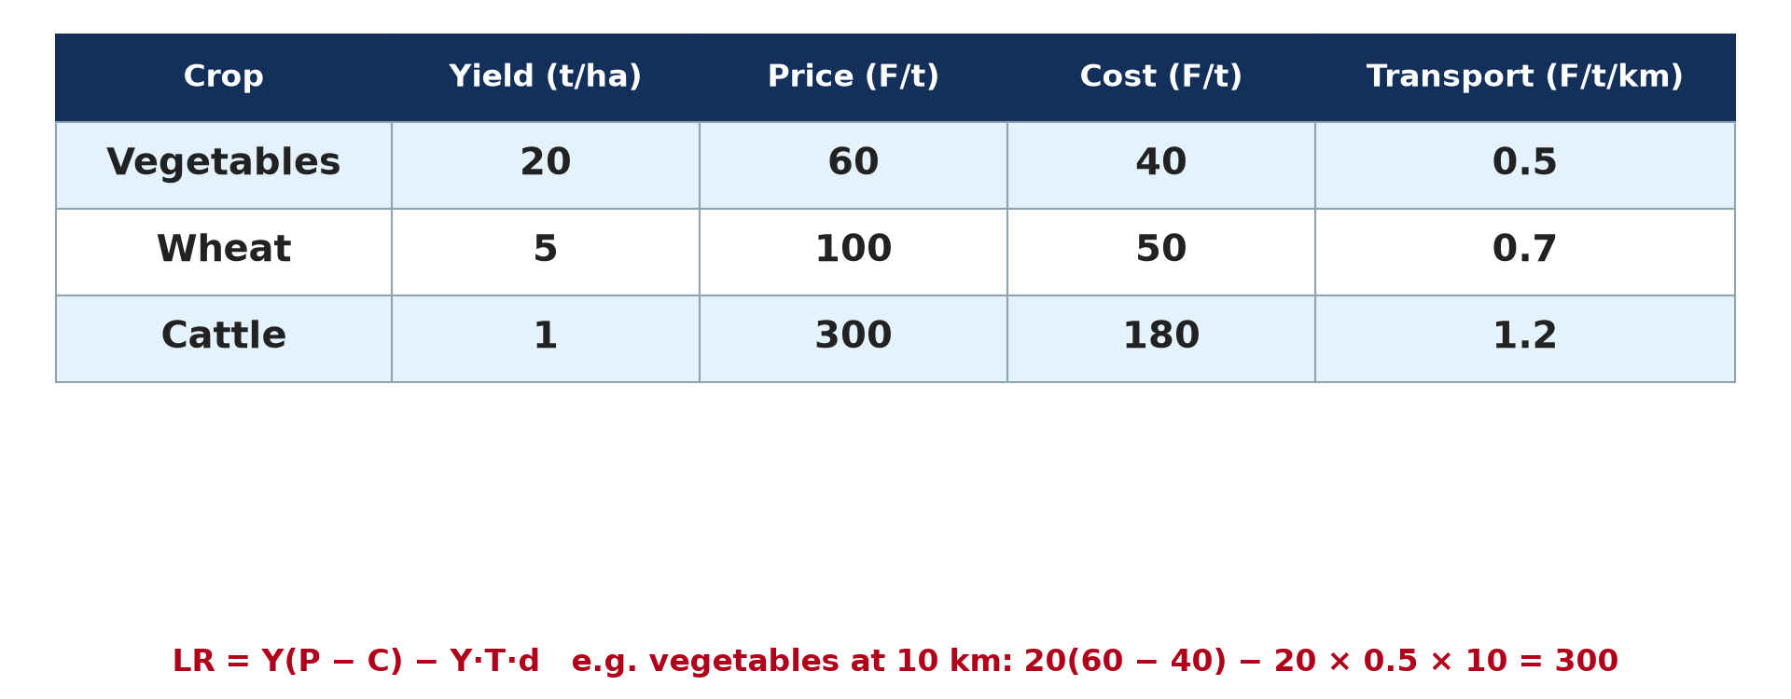
1. THE DATA
Activity 1
Data for three farm products (hypothetical).
Notes:
Activity 1. Look carefully at this diagram: data for three farm products (hypothetical). Observe every detail before I ask the question.

Slide 19
1. THE DATA
Activity 1: Question
Calculate the rent of vegetables at the market (d = 0).
Notes:
Here is the question for Activity 1: Calculate the rent of vegetables at the market (d = 0). Take one minute to think and write your answer in your rough notebook.

Slide 20
1. THE DATA
Activity 1: Answer
20 × (60 − 40) = 400.
Notes:
Let us check the answer together. 20 × (60 − 40) = 400.

Slide 21
2. CALCULATION
Activity 2
The formula.
Notes:
Activity 2. Look carefully at this diagram: the formula. Observe every detail before I ask the question.

Slide 22
2. CALCULATION
Activity 2: Question
Calculate the rent of wheat at 20 km.
Notes:
Here is the question for Activity 2: Calculate the rent of wheat at 20 km. Take one minute to think and write your answer in your rough notebook.

Slide 23
2. CALCULATION
Activity 2: Answer
5 × (100 − 50) − 5 × 0.7 × 20 = 250 − 70 = 180.
Notes:
Let us check the answer together. 5 × (100 − 50) − 5 × 0.7 × 20 = 250 − 70 = 180.

Slide 24
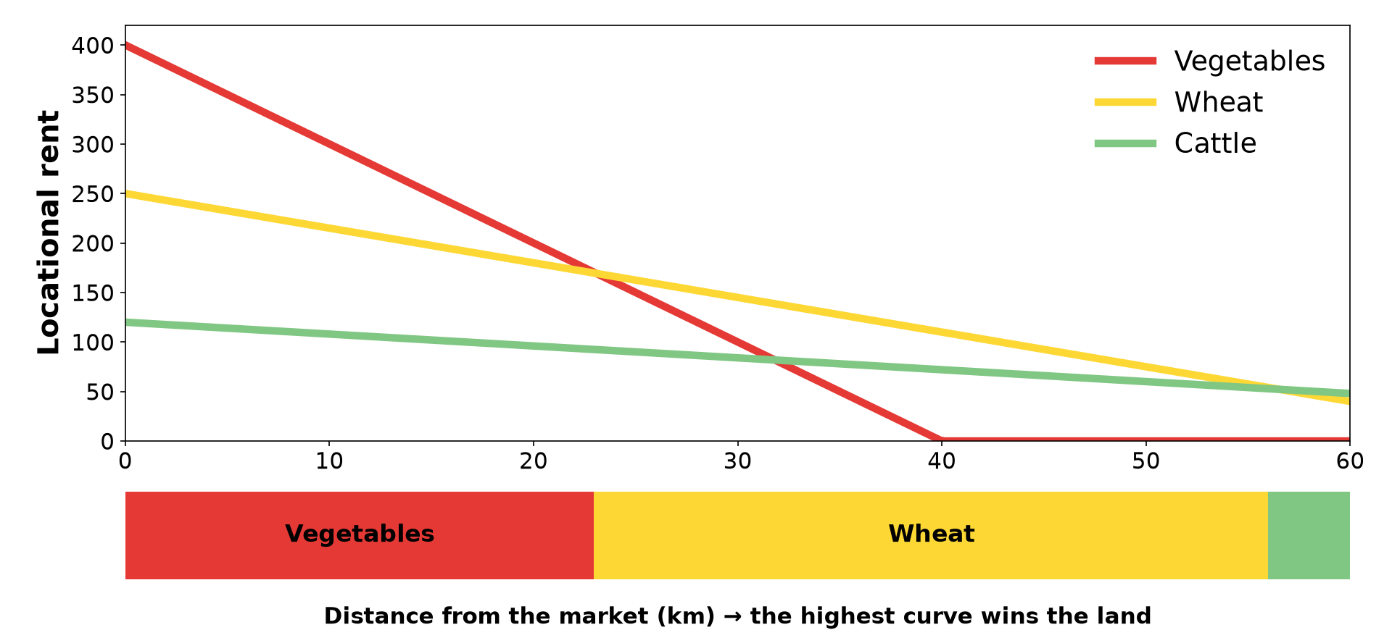
3. RENT CURVES
Activity 3
Rent curves and land use.
Notes:
Activity 3. Look carefully at this diagram: rent curves and land use. Observe every detail before I ask the question.

Slide 25
3. RENT CURVES
Activity 3: Question
At what distance does vegetable rent become zero?
Notes:
Here is the question for Activity 3: At what distance does vegetable rent become zero? Take one minute to think and write your answer in your rough notebook.

Slide 26
3. RENT CURVES
Activity 3: Answer
When 400 − 10d = 0, so at 40 km.
Notes:
Let us check the answer together. When 400 − 10d = 0, so at 40 km.

Slide 27

4. LAND-USE PATTERN
Activity 4
Zones of land use.
Notes:
Activity 4. Look carefully at this diagram: zones of land use. Observe every detail before I ask the question.

Slide 28
4. LAND-USE PATTERN
Activity 4: Question
Where do wheat and cattle zones begin?
Notes:
Here is the question for Activity 4: Where do wheat and cattle zones begin? Take one minute to think and write your answer in your rough notebook.

Slide 29
4. LAND-USE PATTERN
Activity 4: Answer
Wheat where its curve passes above vegetables (about 23 km); cattle beyond about 56 km.
Notes:
Let us check the answer together. Wheat where its curve passes above vegetables (about 23 km); cattle beyond about 56 km.

Slide 30

5. INTERPRETATION
Activity 5
A market.
Notes:
Activity 5. Look carefully at this picture: a market. Observe every detail before I ask the question.

Slide 31
5. INTERPRETATION
Activity 5: Question
What happens to the zones if transport costs fall?
Notes:
Here is the question for Activity 5: What happens to the zones if transport costs fall? Take one minute to think and write your answer in your rough notebook.

Slide 32
5. INTERPRETATION
Activity 5: Answer
The rent curves become flatter and the zones widen outward.
Notes:
Let us check the answer together. The rent curves become flatter and the zones widen outward.

Slide 33
BOARD SUMMARY
Board Summary
Topic: Theories of Agricultural Land Use
Sub-topic: Theories of Agricultural Land Use
Practical Work 1: Calculating Locational Rent and Drawing Rent Curves
Notes:
Now we are going to copy the board summary. Write the title and the headings neatly in your notebooks. I will give you enough time for each slide, so do not rush.

Slide 34
BOARD SUMMARY
DEFINITIONS
The key terms of this lesson are defined as follows:
Locational (economic) rent: It is the profit per unit of land after production and transport costs are paid.
Notes:
Let us copy the definitions. The key terms of this lesson are defined as follows. On this slide we have Locational (economic) rent. Write each point on a new line, with the key term first, and explain it in your own words when we revise.

Slide 35
BOARD SUMMARY
1. Calculation of Locational Rent
Locational rent is calculated as follows:
Formula: LR = Y(P − C) − Y × T × D. Calculate the rent for each crop at several distances.
Notes:
Let us copy Calculation of Locational Rent. Locational rent is calculated as follows. On this slide we have Formula. Write each point on a new line, with the key term first, and explain it in your own words when we revise. When you finish, we go to the next slide.

Slide 36
BOARD SUMMARY
1. Calculation of Locational Rent (continued)
Example: Vegetables: Y = 20, P = 60, C = 40, T = 0.5; at D = 10 km, LR = 20(60 − 40) − 20 × 0.5 × 10 = 400 − 100 = 300. At the market (D = 0), LR = 400.
Notes:
We continue with Calculation of Locational Rent. On this slide we have Example. Write each point on a new line, with the key term first, and explain it in your own words when we revise.

Slide 37
BOARD SUMMARY
1. Calculation of Locational Rent
Illustration: data for three crops
Notes:
Now draw this illustration in your notebook: data for three crops. Give it a title and label it clearly.

Slide 38
BOARD SUMMARY
2. Rent Curves and Land-Use Pattern
Rent curves are drawn and interpreted as follows:
Construction: Put distance on the x-axis and rent on the y-axis, and plot the rent of each crop. The line reaches zero at the margin of cultivation.
Notes:
Let us copy Rent Curves and Land-Use Pattern. Rent curves are drawn and interpreted as follows. On this slide we have Construction. Write each point on a new line, with the key term first, and explain it in your own words when we revise. When you finish, we go to the next slide.

Slide 39
BOARD SUMMARY
2. Rent Curves and Land-Use Pattern (continued)
Land-use pattern: Where curves cross, the most profitable use changes. Projecting the crossing points onto a map gives rings of land use.
Notes:
We continue with Rent Curves and Land-Use Pattern. On this slide we have Land-use pattern. Write each point on a new line, with the key term first, and explain it in your own words when we revise. When you finish, we go to the next slide.

Slide 40
BOARD SUMMARY
2. Rent Curves and Land-Use Pattern (continued)
Interpretation: Steep curves (perishable, heavy crops) occupy land near the market. If transport costs fall, the curves become flatter and the rings widen.
Notes:
We continue with Rent Curves and Land-Use Pattern. On this slide we have Interpretation. Write each point on a new line, with the key term first, and explain it in your own words when we revise.

Slide 41
BOARD SUMMARY
2. Rent Curves and Land-Use Pattern
Illustration: rent curves and zones
Notes:
Now draw this illustration in your notebook: rent curves and zones. Give it a title and label it clearly.

Slide 42
FORMATIVE EVALUATION
Evaluation 1
Calculate the rent of cattle at 50 km (Y = 1, P = 300, C = 180, T = 1.2).
Notes:
Now let us check what you have understood. Question 1: Calculate the rent of cattle at 50 km (Y = 1, P = 300, C = 180, T = 1.2). Answer in your exercise book.

Slide 43
FORMATIVE EVALUATION
Expected Answer
1 × 120 − 1 × 1.2 × 50 = 60.
Notes:
The expected answer is: 1 × 120 − 1 × 1.2 × 50 = 60. If you got it right, well done.

Slide 44
FORMATIVE EVALUATION
Evaluation 2
How do we read land use from rent curves?
Notes:
Now let us check what you have understood. Question 2: How do we read land use from rent curves? Answer in your exercise book.

Slide 45
FORMATIVE EVALUATION
Expected Answer
At each distance, the crop with the highest curve takes the land.
Notes:
The expected answer is: at each distance, the crop with the highest curve takes the land. If you got it right, well done.

Slide 46
REMEDIATION
Remediation
Fill in the blanks:
Rent = Y(P − C) − Y·T·______.
The ______ curve wins the land.
Cheaper transport makes curves ______.
Notes:
For those who need more practice, fill in the blanks in your exercise book. The answers are: number 1, d; number 2, highest; number 3, flatter.

Slide 47
HOMEWORK
Homework
Draw the three rent curves from the table on graph paper and mark the zones.
Notes:
For your homework: Draw the three rent curves from the table on graph paper and mark the zones. We shall correct it at the beginning of our next lesson.

Slide 48
NEXT LESSON
Next Lesson
Our next lesson will be on:
Lesson 7: Sinclair's Model of Agricultural Land Value
Notes:
Our next lesson will be on Lesson 7: Sinclair's Model of Agricultural Land Value. Thank you for your attention, and see you next time.

Slide 49
BILINGUAL GAME
Bilingual Game (Jeu Bilingue)
English | Français
Yield | Le rendement
Price | Le prix
Cost | Le coût
Transport rate | Le tarif de transport
Curve | La courbe
Zone | La zone
Notes:
Let us play the bilingual game. I say a word in English, and you give me the French word. Then we do the reverse.

Slide 50
LOGBOOK
Official Logbook (1/2)
Module / Topic | Theories of Agricultural Land Use
Lesson Title | Practical Work 1: Calculating Locational Rent and Drawing Rent Curves
Expected Learning Outcomes | Apply the locational rent formula. Draw rent curves for several crops. Deduce land use zones from the curves.
Competence | Learners are able to calculate locational rent and draw land use zones.
Notes:
I record this information in the official logbook of the class after the lesson.

Slide 51
LOGBOOK
Official Logbook (2/2)
Matter Taught | DEFINITIONS; Calculation of Locational Rent; Rent Curves and Land-Use Pattern.
Evaluation | Formative evaluation and remediation exercise.
Homework | Draw the three rent curves from the table on graph paper and mark the zones.
Enrolment / Present / Absent | ____ / ____ / ____
Achievement | To be completed after the lesson.
Notes:
I complete the second page of the logbook: the matter taught, the evaluation, the homework and the attendance.

Slide 52
TEACHER'S NOTE
Teacher's Note
Timing: Homework correction, plan, objectives 8 min | Recall, situation, action 10 min | 5 activities 30 min | Board summary (copying) 30 min | Evaluation, remediation 10 min | Homework, next lesson 5 min | Logbook 7 min
Without the projector (Activity 1): copy the table.
Without the projector (Activity 2): calculate for several distances.
Without the projector (Activity 3): plot the points.
Without the projector (Activity 4): mark the zones.
Without the projector (Activity 5): discuss new roads.
Notes:
This slide is for me, the teacher: it gives the timing of the lesson and what to do if the projector is not available.

Slide 53
REFERENCES
References
National Geography Syllabus, MINESEC/IGE/IP-SS, 2019 — Module 6 (Economic Geography).
Photo, Activity 5: “Sandga Market in Douala, Cameroon” by The Advocacy Project, CC BY-NC-SA 2.0, via Flickr (https://www.flickr.com/photos/42487558@N00/3636438732)
Diagrams and animations: drawn for this lesson (Geography Department).
Notes:
These are the references and picture credits used to prepare this lesson.

